Slide 1
Navigation and Steering System
Andy Nguyen, Miles McCloskey, Jonathan Boe,
Arshi Singh, Chase Moynihan, Tan Tran, and Austin Draper

Slide 2
Introduction
This report explains the requirements for the Navigation and Steering System for the Sonny Motor Company’s automobile lines.. It includes the purpose, scope, definitions, acronyms, abbreviations, references, and overview of the system.
The Navigation and Steering system will guide Sonny Motor Company automobiles on city streets and highways from their current locations to user supplied destinations. The system consists of a computer and two steering actuators controlled by the computer. The system will interact with other systems computerized and mechanical, as part of the overall system that is each automobile.

Slide 3
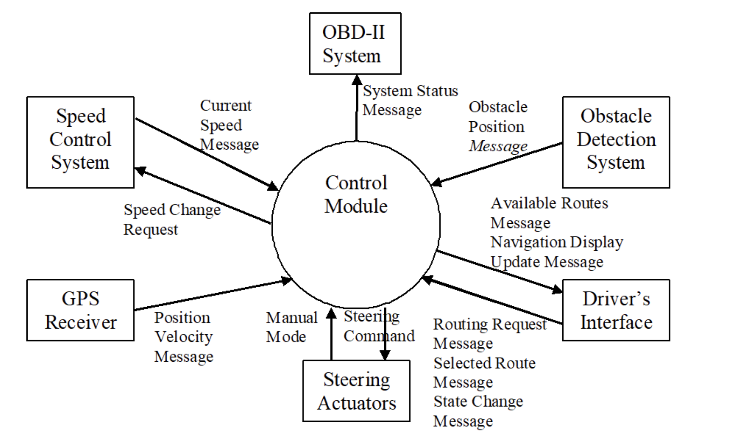

Slide 4
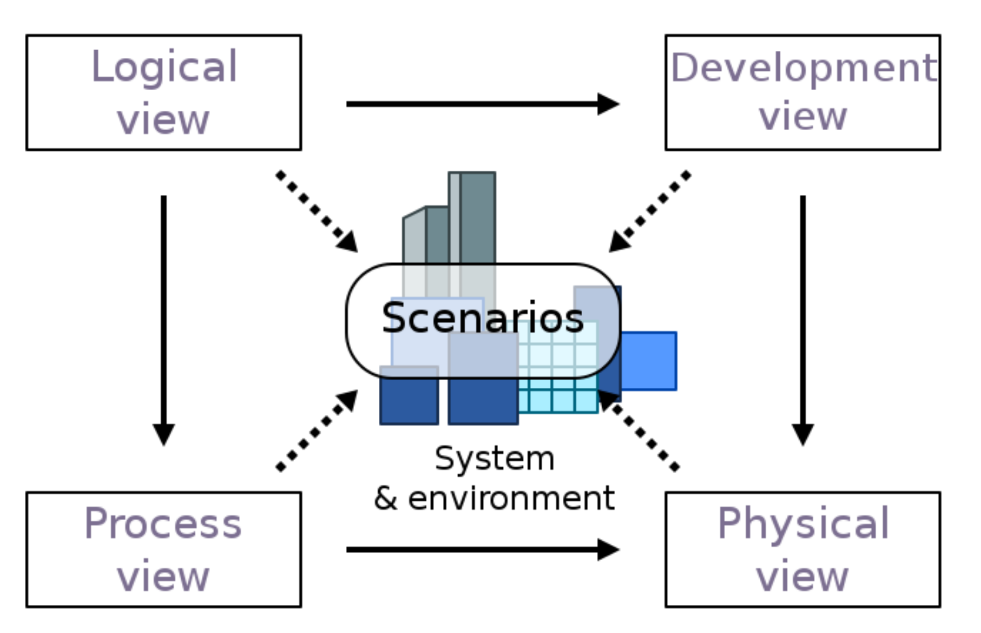
4 + 1 View Model - logical view
Logical view
Audience: NSS designers
Area: Functional Requirements: describes the design’s object model. Will also describe the most architecturally significant use-cases and requirements of the system.
Related Artifacts: Design model

Slide 5
4 + 1 View Model - Process View
Process view
Audience: Integrators
Area: Non-functional requirements: describes the design’s concurrency and synchronization aspects. How logical view components are associated to the processes.
Related Artifacts: Process View document

Slide 6
4 + 1 View Model - Development View
Development view
Audience: Programmers
Area: Software components: describes the modules as well as the subsystems of the application. Describes the structural organization of elements used on the system such as object files, libraries, and test codes.
Related Artifacts: Deployment document

Slide 7
4 + 1 View Model - Physical View
Physical view
Audience: Deployment managers
Area: Describes the mapping of the software onto the hardware. Also shows the distributed aspects of the system.
Related Artifacts: Physical Document

Slide 8
4 + 1 View Model - Use Case/Scenario View
Use Case/Scenario view
Audience: All stakeholders of the system, including the end-users
Area: Describes the set of scenarios/use cases which are critical to the architecture
Related Artifacts: Use Case Diagram

Slide 9
Architectural Goals and Constraints
The architectural goals listed below were chosen by selecting the architecturally significant requirements from a list containing all current functional and non-functional requirements
4.1 Position and Velocity Sensing
4.2 Route Selection
4.3 Steering
4.4 Obstacle Avoidance
4.5 Driver Controls
4.6 Emergency Actions
4.7 Diagnostic Information Generation
4.8 Reliability
4.9 Availability
4.10 Portability

Slide 10
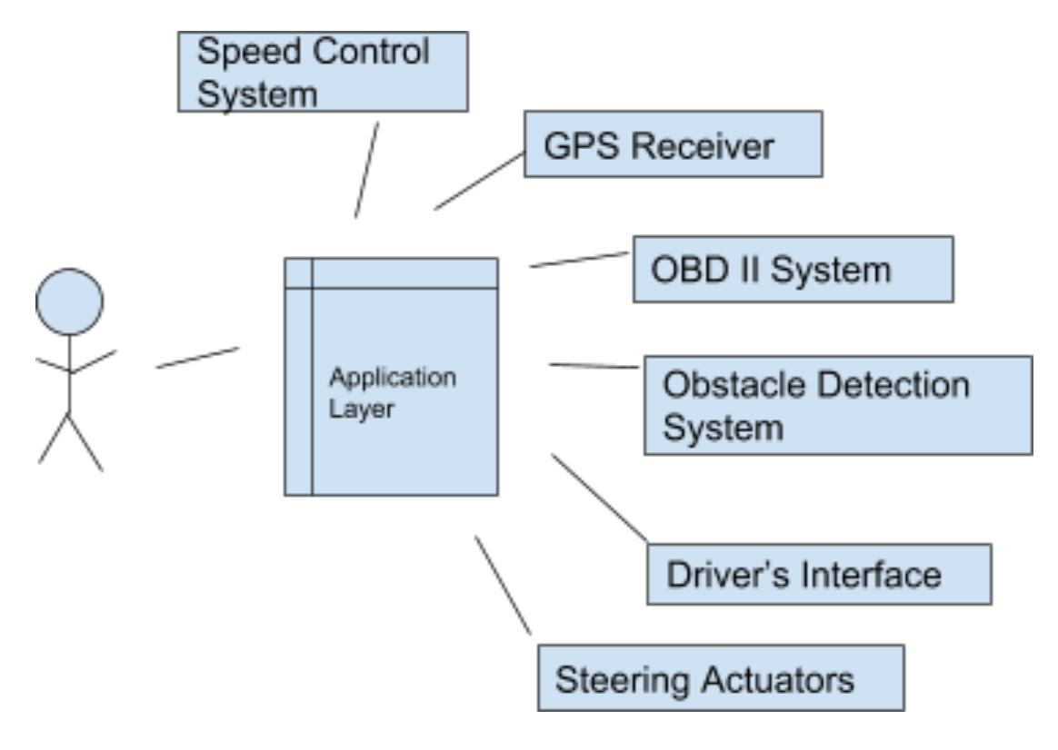
Logical Architecture
User interface - It contains classes for each of the actors use to communicate with the system. Classes would include to GPS routes, Speed calculations, Redirecting routes due to obstacles.
Application Layer - This case would have the main applications performed by the system. The application would send and receive requests from the users.
Subsystems - Subsystems such as Speed Control System, Driver’s Interface, GPS Receiver, Steering Actuators, Obstacle Detection System.

Slide 11
Process Architecture
6.1 UpdatePositionAndVelocity
6.2 CeaseAutoSteering
6.3 MakeNDU
6.4 DetermineRoutes
6.5 MakeARM
6.6 ActivateAutoSteering
6.7 CalculateSteering
6.8 MakeSCR
6.9 SuspendAutoSteer
6.10 ResumeAutoSteer
6.11 MakeDiagnosis

Slide 12
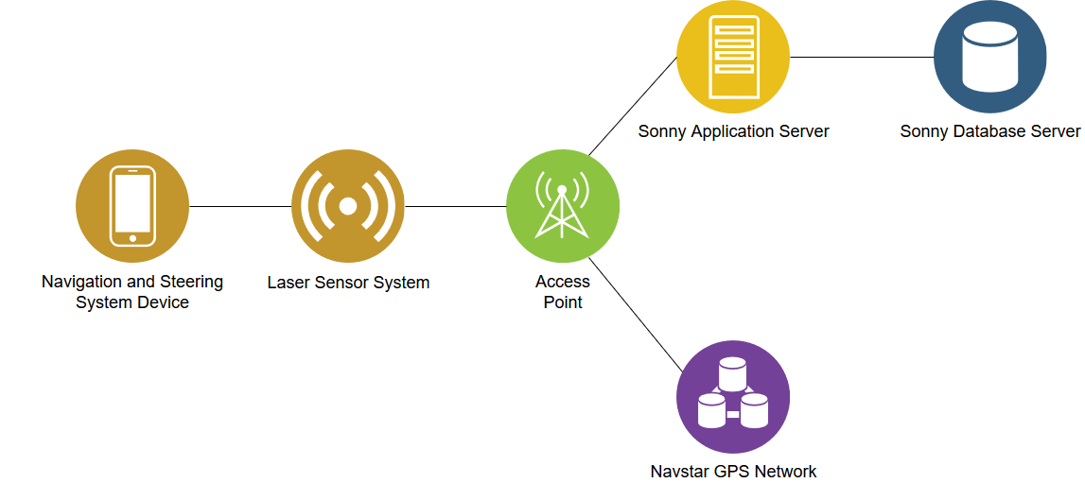
Physical Architecture
Uses lasers, access points, and connections to servers & networks
NSS Device transmits lasers
Access points boost the connection of laser sensors to reach servers and networks
Sonny servers and Navstar transmit up-to-date information like current position

Slide 13
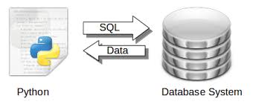
Development Architecture
SQL
Reliable connection protocol
Python Data analysis library Panda

Slide 14
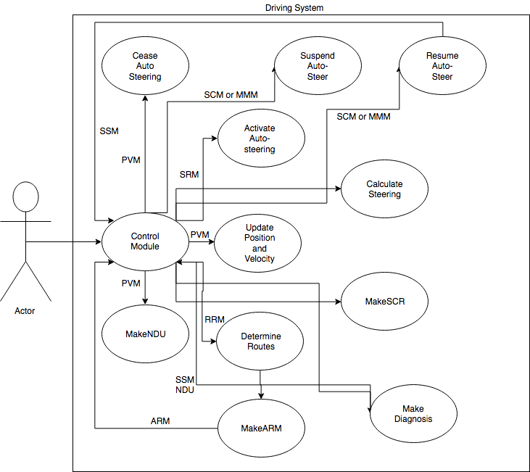
Scenarios

Slide 15
UpdatePositionAndVelocity - USE CASE
3.2.1 UpdatePositionAndVelocity
Use Case # 1
Objective: l
Priority: Very High
Actor: Control Module
Basic Flow
Control Module receives positional data from vehicle sensors
Alternate Flow: NONE
Precondition: User must be connected to network
Postcondition: Vehicle status will be updated
Notes:
[SN-001] The system shall update its current position and velocity upon receipt of valid Position Velocity Messages.
[SN-002] The system shall cease automatic steering if 3 (adaptable) consecutive invalid messages are received within 2 seconds (adaptable).
[SN-003] The system shall cease automatic steering if 3 (adaptable) consecutive Position Velocity messages indicating GPS signal integrity errors are received within 2 seconds (adaptable).
[SN-004] The system shall generate a Navigation Display Update message indicating the vehicle’s current position after every 4th (adaptable) valid Position Velocity Message.

Slide 16
CeaseAutoSteering - USE CASE
3.2.2 CeaseAutoSteering
Use Case # 2
Objective: Cease auto steering if conditions are met
Priority: Very High
Actor: Control Module
Basic Flow
Receives three consecutive invalid messages within 2 seconds or,
Cannot avoid obstacle within 100ms or,
Receives a state change message or,
System detects error
Alternate Flow: NONE
Precondition: One of the basic flows mentioned above
Postcondition: Auto steering will halt

Slide 17
MakeNDU - USE CASE
3.2.3 MakeNDU
Use Case # 3
Objective: Error checking the PVM, and updating the Navigation Display with the current position
Priority: High
Actor: Control Module
Basic Flow
After receiving a valid PVM, this process will check if it is one of every 4th such PVM’s sent
Includes: PVM
Precondition: A valid Position Velocity Message (PVM)
Postcondition: This process will send a Navigation Display Update (NDU) with the vehicle’s current position.
Notes:
Upon receiving a valid PVM, this process will check if it is one of every 4th such PVMs sent so far. If so, this process will send a Navigation Display Update (NDU) with the vehicle’s current position.

Slide 18
DetermineRoutes - USE CASE
3.2.4 DetermineRoutes
Use Case # 4
Objective: Determines 3 possible routes for user to choose from
Priority: High
Actor: Driver
Basic Flow
System receives a valid routing request message (made by the user)
System generates three routes that begin at vehicles current position and end at destination
Alternate Flow: NONE
Includes: Control Module
Precondition: User must have a destination selected and be connected to the network
Postcondition: Three routes will be generated for the user to choose from
Notes:
[SN-005] Upon receipt of a valid Routing Request Message, the system shall determine up to 3 (adaptable number) of routes from the vehicle’s current position to the specified destination.
[SN-006] The generated routes shall be sent in one or more Available Routes Messages.
[SN-007] An Available Routes message indicating that no routes are available shall be generated if the system is unable to determine a route to the specified destination.

Slide 19
MakeARM - USE CASE
3.2.5 MakeARM
Use Case # 5
Objective: To send the client one available route message
Priority: Medium
Actor: Control Module
Basic Flow
Checks for available routes to the destination
if route is available, then it sends it
If no route is available, an ARM will be sent notifying that no routes are available to be taken
Includes: NONE
Precondition: Must have a destination and a starting current position
Postcondition: Being sent an ARM with optimized route, and if no routes available then it sends no routes are available.
Notes:
This process will check for available routes to the destination. If at least one such route is available, this process will then send one Available Route Message (ARM) for each available route.

Slide 20
Non-Behavioral Requirements
Reliability
The system’s Mean Time Between Failure (MTBF) will be required to be less than twelve months. A failure is defined as any error within the system that causes it to cease automatic steering, or any error that causes the system to behave in an unsafe manner.
The system's Mean Time To Recovery (MTTR) will be required to be 2 hours and less time. Recovery is defined as the process of restoring functionality after a system failure.
Availability
The Navigation and Steering System (NSS) shall be achieve a minimum of 99.5% uptime.
Navigation Display Update (NDU) messages indicating current vehicle position shall be generated 99.9999% of the time while the vehicle is operating.
Routes will generate at least 95% of test cases supplied by customer.
Portability
The source code should be designed to run on different processors to improve portability.
The source code should be able to compile and execute on major operating systems such as Windows 10, macOS, and Linux.
All recording of date and time shall be stored in UTC (Universal Time Coordinated) to maintain consistency.

Slide 21
Non-Behavioral Requirements (Continued)
Survivability
The system shall backup data at a maximum of every three hours to prevent loss of data.
Recovering data from a backup shall not exceed a length of an hour.
Customer service support tickets through email shall be resolved 90% of the time within one week.
Efficiency
All recordings of time shall be accurate up to one nanosecond.
Database queries shall take less than five seconds under maximum load.
The system should able to process a minimum of 100,000 queries per hour under maximum load.
The maximum storage capacity of the server(s) shall scale with the number of users.
The storage capacity shall have at least 20 percent of reserved space available under maximum load.

Slide 22
Reference
Howell, E. (2013). Navstar: GPS Satellite Network. Retrieved March 18, 2018, from https://www.space.com/19794-navstar.html
Kruchten, P. (1995). Architectural Blueprints—The “4+1” View Model of Software Architecture. [online] Cs.ubc.ca. Available at: http://www.cs.ubc.ca/~gregor/teaching/papers/4+1view-architecture.pdf [Accessed 11 Mar. 2018].
En.wikipedia.org. (2018). 4+1 architectural view model. [online] Available at: https://en.wikipedia.org/wiki/4%2B1_architectural_view_model [Accessed 4 Mar. 2018].

